Slide 1
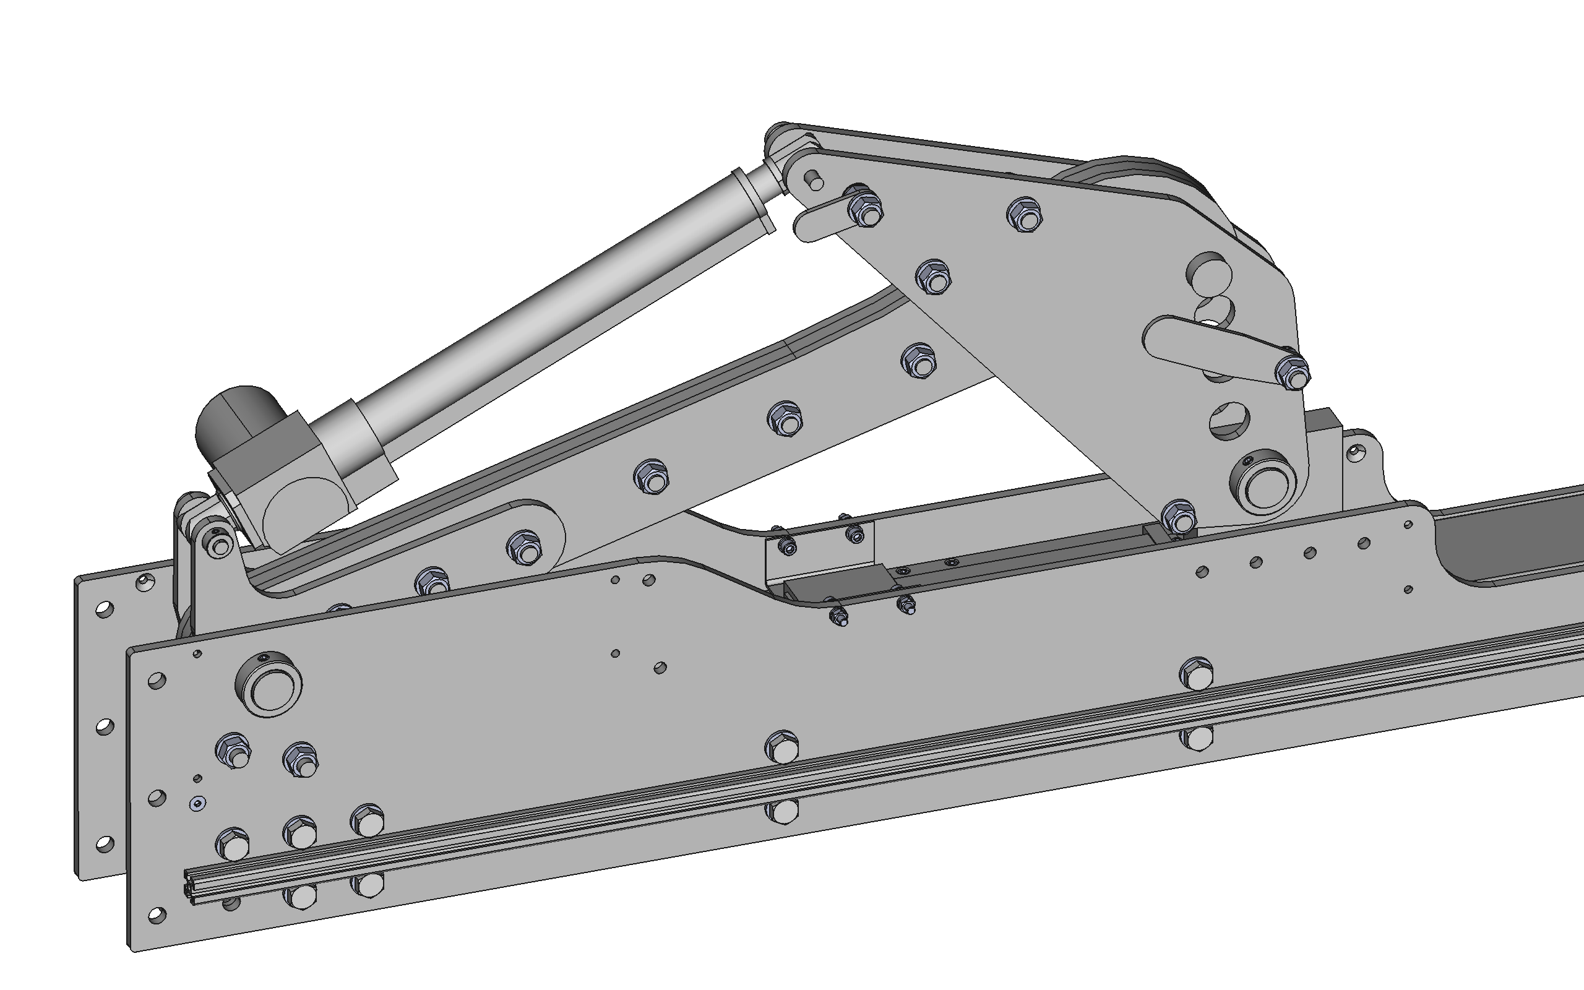
Attach actuator with 10mm diameter pin and secure retaining plate in place
Install 30mm diameter range pin on 160mm travel range and secure retaining plate in place

